Slide 1
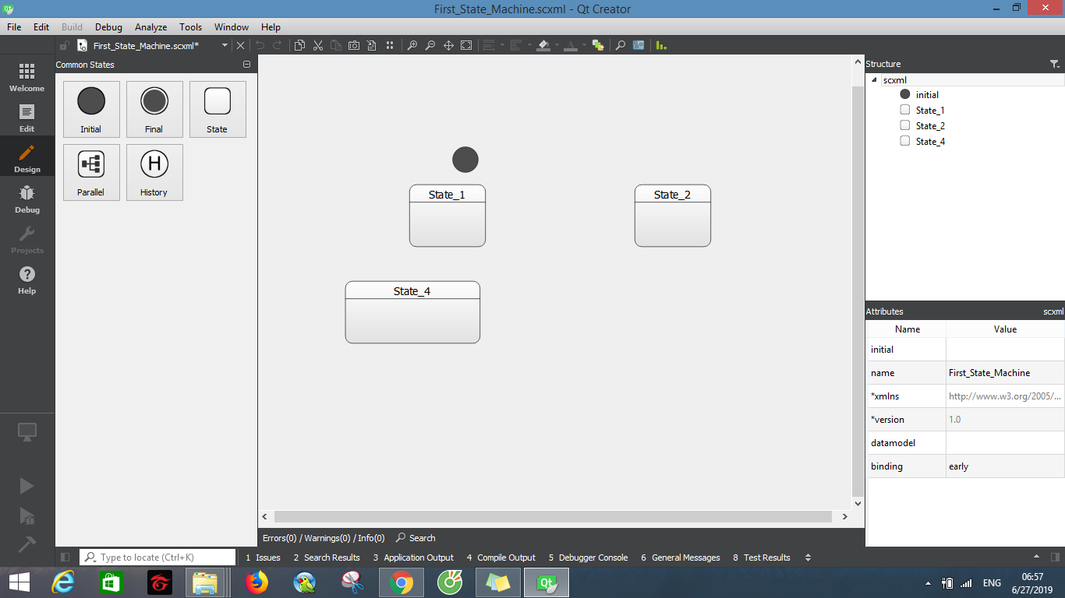
QT CREATOR

Slide 2
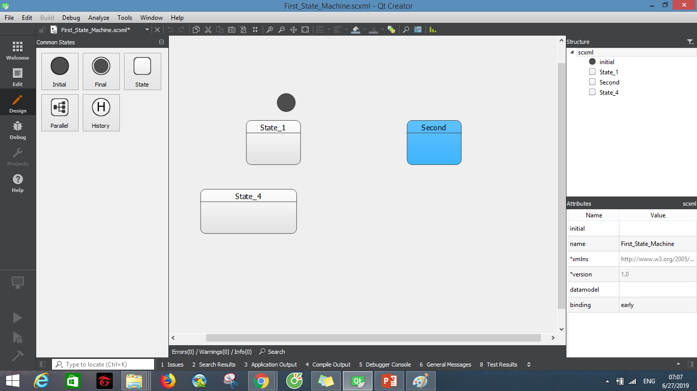
QT CREATOR

Slide 3
QT CREATOR
State
Transition
Events
Data model
Can change color of each state.
Editor SCXML available from QtCreator 4.2

Slide 4
QT CREATOR
Theme is easily to use.
Can view statisc of structure (how many state, how many scxml file will be created, max level of structure).
Can change color of each state.
Can export to image
Snapshot picture
Change size of state
Have symbol for state start and final
Support diff to view difference between modified file and last saved file

Slide 5
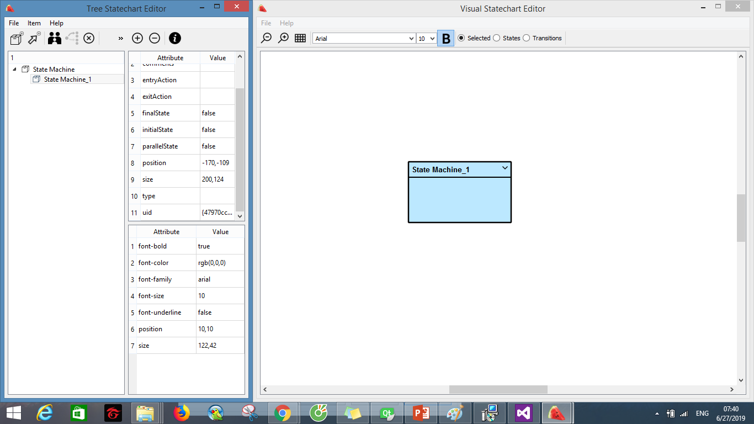

Slide 6
Visual statechart
The visualsc project is an open source project which will provide a hierarchical state-chart editor, which stores the charts in state-chart-xml (scxml).
Support operating system Windows, no Linux version
The size of Visual statechart is quite small (around 60 MB) compare to
Qt Creator.
Need to install on Windows

Slide 7
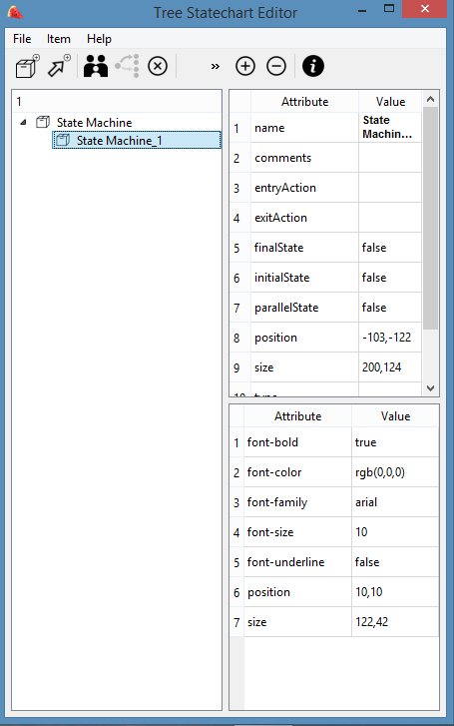
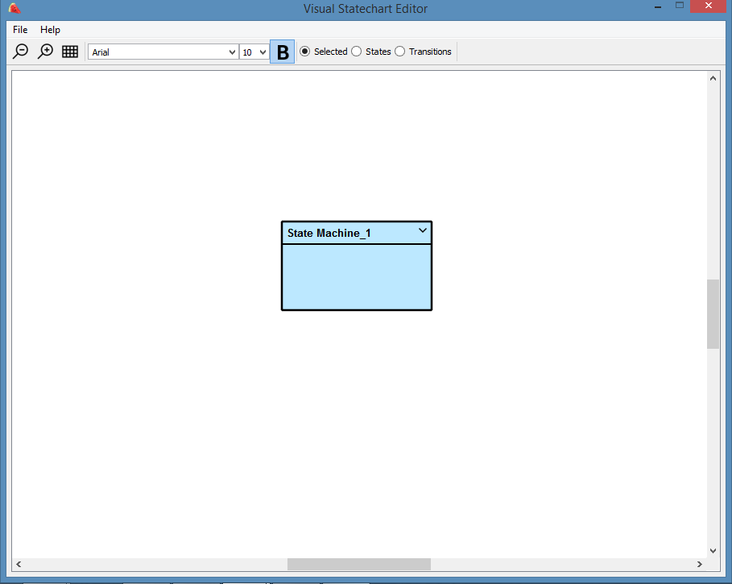
feature
Visual state chart use two windows for drawing state chart: the formview is used for adjust attribute of object state chart, display a tree widget for hierarchical navigation of the state chart and the GraphicsView is used for display graphic.
The formview
The Graphicsview

Slide 8
feature
Visual state chart support for many different font
Two windows is opened independently. Example, when we open another program (Excel, World) then came back to Visual state chart. Two windows is not show at the same time, we have to click on both windows to open it.
Can adjust the color but we have to do this in windows formview in text format, example rgb(0,0,0). So it’s not support
Have some type of state such as begin and end

Slide 9
feature
Support for adding comment in each state.
Some type of state:
finalState: state enable finish of state machine.
initialState: state begin when it start.
parallelState: state parallel with other state.
Has entry Action, exitAction

Slide 10
evaluation
Advantage:
The program has small size
Easy to use, draw and export scxml file
Support init state, final state, parrellel state.
Can change color of state, change font

Slide 11
evaluation
Disadvantage:
Need to click on both windows to show these windows at the same time
Change color in text format
Sometimes it crash and exit program.
After a period of time, Visual State Chart take much usage from CPU (about 30%)
Need install on Windows and evaluation IT before applying Visual State Chart.

Slide 12
scxmlgui
Disadvantage:
Need to click on both windows to show these windows at the same time
Change color in text format
Sometimes it crash and exit program.
After a period of time,
Need install on Windows and evaluation IT before applying Visual State Chart.

Slide 13
Visual statechart
Just edit directly on graphic, can’t edit use nagivator tool on the left like Qt Creator
Not consistency in between two windows
Can change size but have used text, not change on graphic
Small size
Not support to view scxml directly, first we have to save the chart then we can view it
It take much %CPU. Around 30% so although it has small size but take much CPU

Slide 14
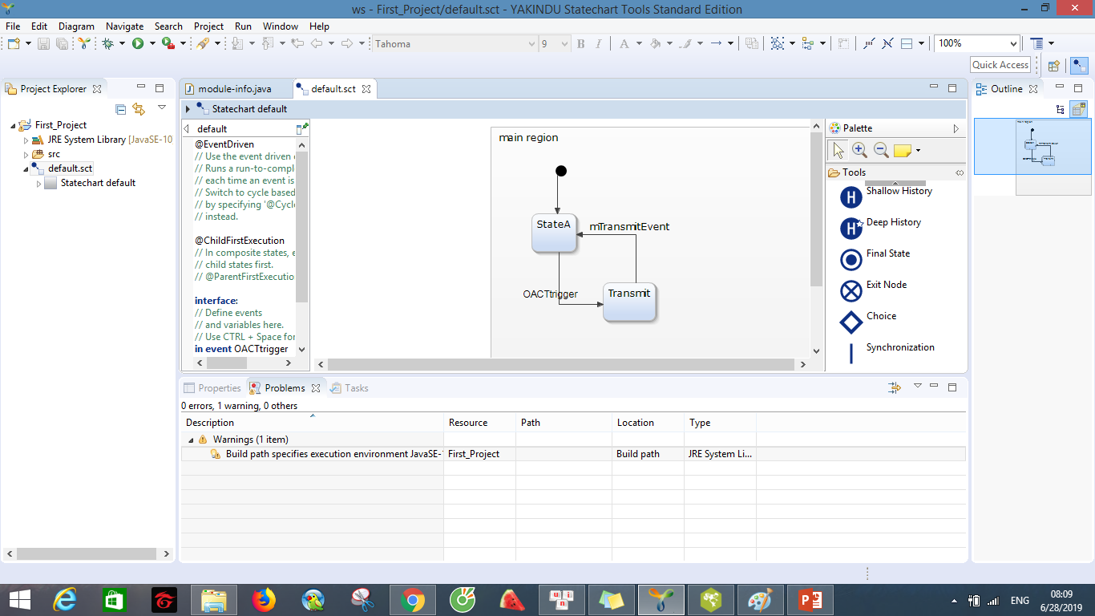
Yakindu state chart tool
Support many operating system (Linux, Windows, MACOSX)
DRAKON Editor is a free tool

Slide 15
Yakindu state chart tool
Yakindu support many kind of state: state, composite state, orthogonal state, shallow history, deep history, final state, exit node, choice
Theme based on Eclipse. So the process to create new statechart is like Eclipse.
It support comment on state, and support change color or font of state by GUI, not text format. We can change by click on state then choose the color or font we want to use (like World).
Support a button to choose all shapes.By click this button, Yakindu will choose all state chart
Support to align (center, left, right,…)

Slide 16
Yakindu state chart tool
It’s also easy to use like two previous software
Support document on Help tab

Slide 17
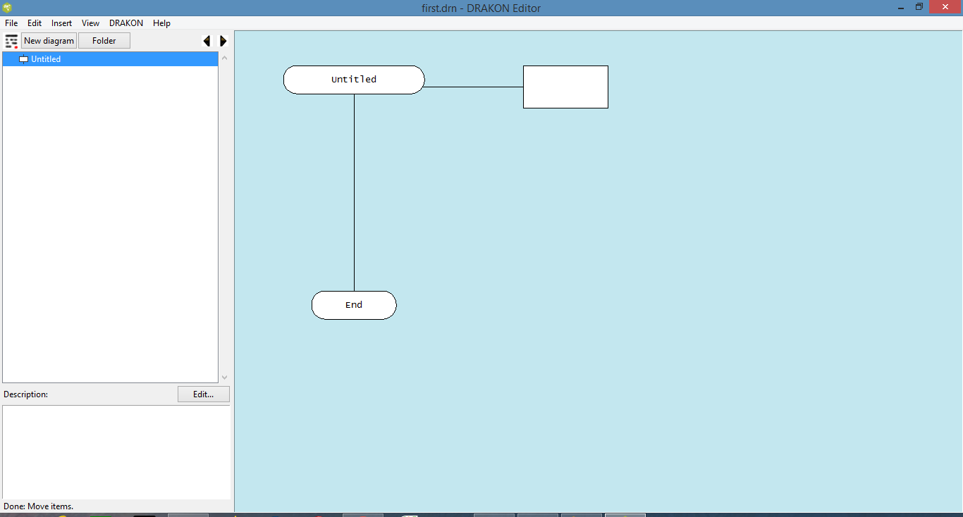
DRAKON
Support many operating system (Linux, Windows, MACOSX)
Two kind of version free and commercial

Slide 18
Drakon editor
Support many operating system (Linux, Windows, MACOSX)

